Slide 1

Expected Value in
Games of Chance
Written by Rachel J. Morris, last updated Feb 26, 2018

Slide 2

About
When we have some probability associated with several outcomes, we can estimate the expected outcome we will receive. This is essentially just the average value given all the outcomes and their weights.

Slide 3
Topics
1. Average Value
2. Expectation in Bernoulli Trials

Slide 4

Average Value

Slide 5

1. Average Value
Notes
Expected Value
E[X] = x1 * Prob(X = x1) + …
+ xn * Prob(X = xn)
For a given probability experiment, let X be a random variable whose possible values come from the set of numbers { x₁, …, x_{n} }. Then the expected value of X, denoted by E[X], is the sum
x₁ * Prob(X = x₁) + x₂ * Prob(X = x₂) + … + x_{n} * Prob(X = x_{n})
This is sometimes called the average value of the random variable, thinking of the average of the values X takes on over many repetitions of the experiment.
From Discrete Mathematics, Ensley & Crawley, page 467
(<number>/19)

Slide 6
1. Average Value
Notes
Expected Value
E[X] = x1 * Prob(X = x1) + …
+ xn * Prob(X = xn)
As an example, let’s roll a fair die. We can get 1 through 6, and we have 1/6 chance of getting any value.
Let’s write a program to run this trial as a simulation, and average together the values received from the virtual die rolls.
Then, we will calculate the expected value using the formula and compare.
(<number>/19)

Slide 7
1. Average Value
Python Code
import random
def RollDie():
return random.randint( 1, 6 )
# ---------------------------------------------------- #
rolls = int( input( "Roll the die how many times? " ) )
sum = 0
count = 1
for i in range( rolls ):
roll = RollDie()
sum += roll
print( "Roll " + str( count ) + ": " + str( roll ) )
count += 1
average = float( sum ) / float( rolls )
print( "" )
print( "Rolled " + str( rolls ) + " times." )
print( "Average value from rolls: " + str( average ) )
In this code, we have a function that “rolls” the dice, and we run the trial any amount of times.
Once we’re done with the trials, we average the values together.
Notes
Expected Value
E[X] = x1 * Prob(X = x1) + …
+ xn * Prob(X = xn)
(<number>/19)

Slide 8
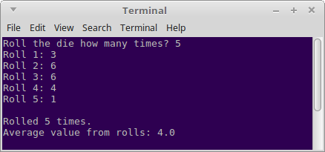

1. Average Value
We can run the program multiple times and we will get different average values each time because of the randomness.
Notes
Expected Value
E[X] = x1 * Prob(X = x1) + …
+ xn * Prob(X = xn)
(<number>/19)

Slide 9
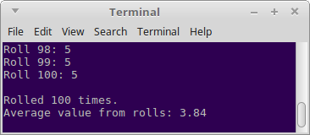
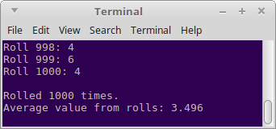
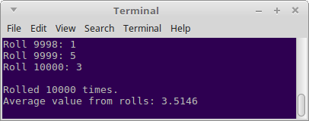
1. Average Value
But as we roll the die more frequently, we converge on some value…
Notes
Expected Value
E[X] = x1 * Prob(X = x1) + …
+ xn * Prob(X = xn)
(<number>/19)

Slide 10
1. Average Value
Now let’s calculate the average value.
Notes
Expected Value
E[X] = x1 * Prob(X = x1) + …
+ xn * Prob(X = xn)
Outcome | Value x_{n} | Prob(X = x_{n})
x₁ | 1 | 1/6
x₂ | 2 | 1/6
x₃ | 3 | 1/6
x₄ | 4 | 1/6
x₅ | 5 | 1/6
x₆ | 6 | 1/6
(<number>/19)

Slide 11
1. Average Value
Now let’s calculate the average value.
Notes
Expected Value
E[X] = x1 * Prob(X = x1) + …
+ xn * Prob(X = xn)
Outcome | Value x_{n} | Prob(X = x_{n})
x₁ | 1 | 1/6
x₂ | 2 | 1/6
x₃ | 3 | 1/6
x₄ | 4 | 1/6
x₅ | 5 | 1/6
x₆ | 6 | 1/6
(<number>/19)

Slide 12
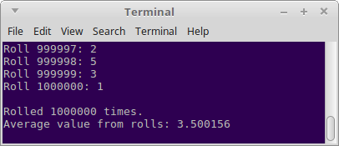
1. Average Value
Now let’s calculate the average value.
Notes
Expected Value
E[X] = x1 * Prob(X = x1) + …
+ xn * Prob(X = xn)
We can compare it to the simulation and see that they are close to the same value.
(<number>/19)

Slide 13
Expectation in
Bernoulli Trials

Slide 14
2. Expectation in Bernoulli Trials
Notes
Expected Value
E[X] = x1 * Prob(X = x1) + …
+ xn * Prob(X = xn)
Expected Value in a
Bernoulli Trial
E[X] = n * p
Theorem 1: Suppose an experiment consists of the independent repetition of a trial n times, and the probability of that trial’s individual success is p each time it is performed. If X denotes the number of successful trials in this experiment, then
E[X] = n * p
From Discrete Mathematics, Ensley & Crawley, page 469
(<number>/19)

Slide 15
2. Expectation in Bernoulli Trials
Notes
Expected Value
E[X] = x1 * Prob(X = x1) + …
+ xn * Prob(X = xn)
Expected Value in a
Bernoulli Trial
E[X] = n * p
As another example, let’s use the die problem, but in this case we are going to consider getting a 1 as a “success” and anything else as a “failure”. Our outcomes { x₁, …, x_{n} } will denote the amount of successes we receive.
(<number>/19)

Slide 16
2. Expectation in Bernoulli Trials
Notes
Expected Value
E[X] = x1 * Prob(X = x1) + …
+ xn * Prob(X = xn)
Expected Value in a
Bernoulli Trial
E[X] = n * p
Bernoulli trial
n: # of trials
p: Probability of one success
k: Amount of successes
For the die trial, let’s say we are going to roll the die 5 times. We want to see the expected value.
Outcome | Value x_{n} | Prob(X = x_{n})
0 successes | 0 | C(5, 0) * (1/6)⁰ * (5/6)⁵
1 success | 1 | C(5, 1) * (1/6)¹ * (5/6)⁴
2 successes | 2 | C(5, 2) * (1/6)² * (5/6)³
3 successes | 3 | C(5, 3) * (1/6)³ * (5/6)²
4 successes | 4 | C(5, 4) * (1/6)⁴ * (5/6)¹
5 successes | 5 | C(5, 5) * (1/6)⁵ * (5/6)⁰
(<number>/19)

Slide 17
2. Expectation in Bernoulli Trials
Notes
Expected Value
E[X] = x1 * Prob(X = x1) + …
+ xn * Prob(X = xn)
Expected Value in a
Bernoulli Trial
E[X] = n * p
Bernoulli trial
n: # of trials
p: Probability of one success
k: Amount of successes
For the die trial, let’s say we are going to roll the die 5 times. We want to see the expected value.
Outcome | Value x_{n} | Prob(X = x_{n})
0 successes | 0 | C(5, 0) * (1/6)⁰ * (5/6)⁵ | = 3125/7776
1 success | 1 | C(5, 1) * (1/6)¹ * (5/6)⁴ | = 3125/7776
2 successes | 2 | C(5, 2) * (1/6)² * (5/6)³ | = 625/3888
3 successes | 3 | C(5, 3) * (1/6)³ * (5/6)² | = 125/3888
4 successes | 4 | C(5, 4) * (1/6)⁴ * (5/6)¹ | = 25/7776
5 successes | 5 | C(5, 5) * (1/6)⁵ * (5/6)⁰ | = 1/7776
(<number>/19)

Slide 18
2. Expectation in Bernoulli Trials
Notes
Expected Value
E[X] = x1 * Prob(X = x1) + …
+ xn * Prob(X = xn)
Expected Value in a
Bernoulli Trial
E[X] = n * p
Bernoulli trial
n: # of trials
p: Probability of one success
k: Amount of successes
For the die trial, let’s say we are going to roll the die 5 times. We want to see the expected value.
If we calculate it the long way like this, we get 5/6. We can also use the theorem:
(That was easier!)
(<number>/19)

Slide 19
Conclusion
Now we’ve covered the major parts of Chapter 6 – Finding probability, using the Sum and Product rules, and finding Expected Values.

